Slide 1

Using Regression Trees to Predict COVID-19 Death Cases
Chiyun Liu & Yunting Chiu / STAT-615 at American University / Spring 2021

Slide 2
Classification And Regression Trees (CART)
Classification Tree: response variable is categorical
Regression Tree: response variable is numeric

Slide 3
When should we use Regression Tree ?
Non-Linearity
Cannot use a parametric method

Slide 4

Pros of Regression Tree
The Results is simple
Nonparametric & Nonlinear
Perform Feature Selection

Slide 5
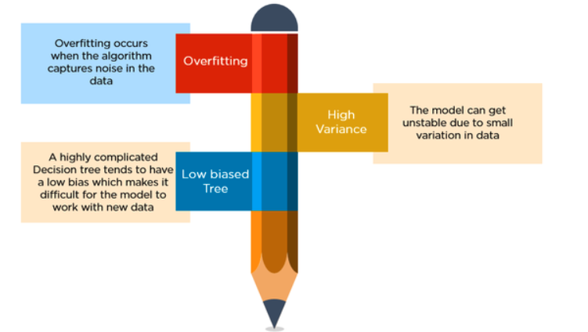
Cons of Regression Tree
Overfitting
High variance
Low bias
Source: Sonish Sivarajkumar from Medium

Slide 6
Case Study - Predict COVID-19 Death Cases
51 Observations (50 US States + DC) & 12 Variables | Source
confirmed | CSSE at Johns Hopkins University (2020/01/22 - 2021/01/22)
deaths | CSSE at Johns Hopkins University (2020/01/22 - 2021/01/22)
American_Indian_and_Alaska_Native_alone | 2019 American community survey estimate, US Census Bureau
Asian_alone | 2019 American community survey estimate, US Census Bureau
Black_or_African_American_alone | 2019 American community survey estimate, US Census Bureau
Native_Hawaiian_and_Other_Pacific_Islander_alone | 2019 American community survey estimate, US Census Bureau
Some_other_race_alone | 2019 American community survey estimate, US Census Bureau
Two_or_more_races | 2019 American community survey estimate, US Census Bureau
White_alone | 2019 American community survey estimate, US Census Bureau
2021 Median household Income by states | Tidy from World Population Review, raw data from US Census Bureau
Latitude | Kaggle
Longitude | Kaggle

Slide 7
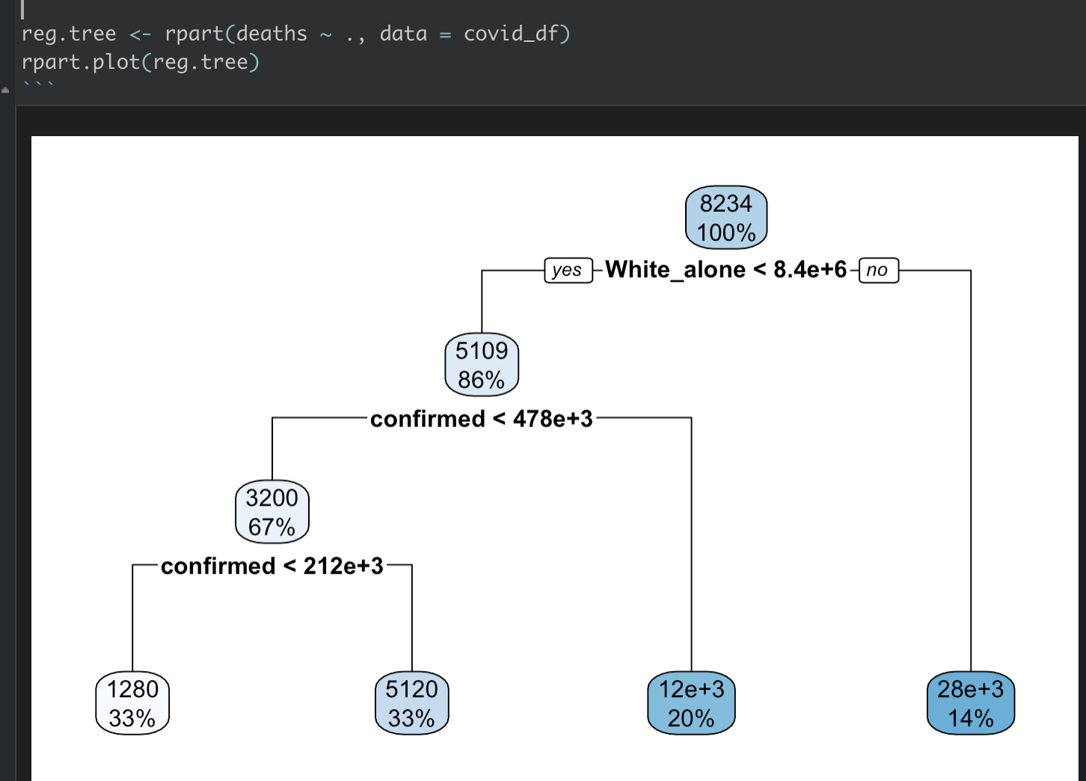

Slide 8
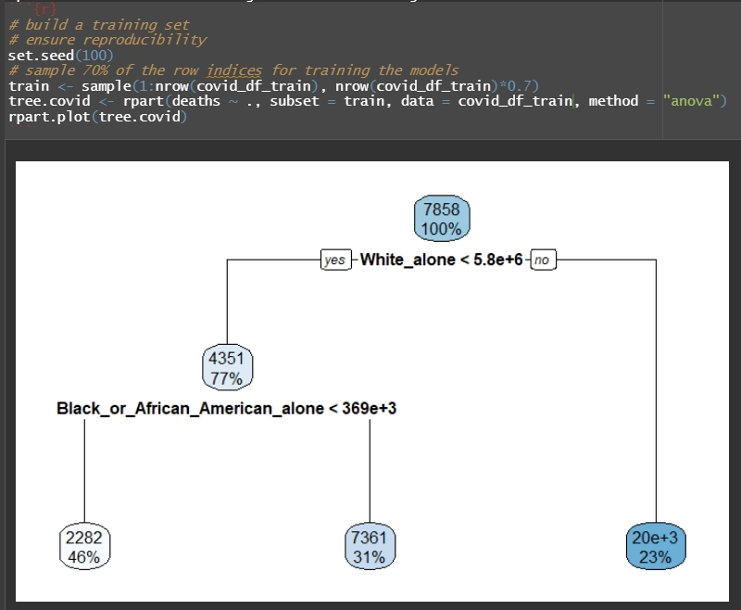
Build a regression tree to predict the death
Randomly split into:
70 % for training
30% for testing
method = “anova”
Y is continuous
(Regression Tree)
method = “class”
Y is a factor
(Classification Tree)

Slide 9
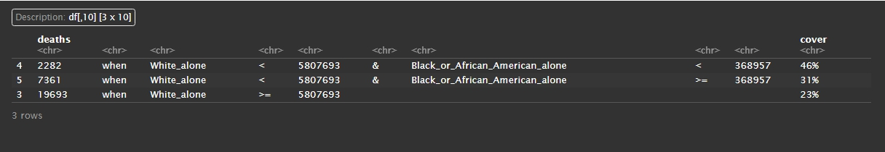
Print the rules of regression tree

Slide 10
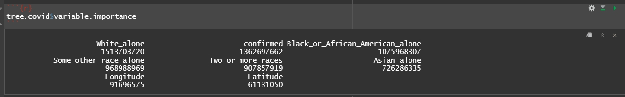
The most important factors in determining Death Cases are:

Slide 11
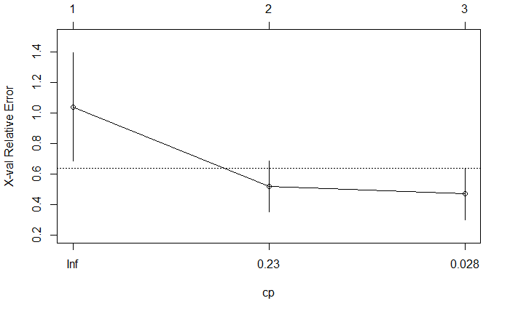
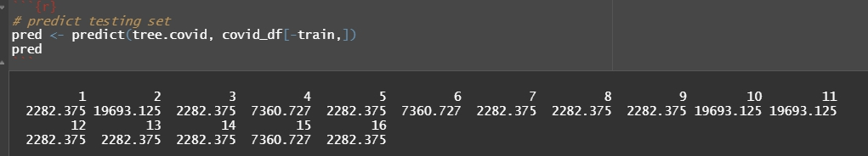
Cross-validation
Predict
X-axis :Cp (Complexity parameter)
Control the size of the decision tree
select the optimal tree size.
Y-axis: X-val Relative Error
The relative cross validation error for various cp values .
Smaller cp values lead to larger trees

Slide 12

Conclusion
Decision Tree
Non-parametric
No need to assume linearity and normality
Build non-linear model
Regression Tree
Predict continuous Y
Classification Tree
Predict categorical Y

Slide 13
References
[1] Sivarajkumar, S. (2019, May 7). Classification and Regression Trees. Medium. https://medium.com/@sonish.sivarajkumar/classification-and-regression-trees-f3e58be39f86#:~:text=A%20regression%20tree%20refers%20to,is%20a%20continuous%20dependent%20variable.
[2] Yobero, C. (n.d.). Predicting Baseball Player Salaries Using Regression Trees. RPubs by RStudio.
https://rpubs.com/cyobero/regression-tree.
[3] Jamleecute. (2019, April 14). Decision Tree 決策樹: CART, Conditional Inference Tree, RandomForest. 果醬珍珍•JamJam. https://www.jamleecute.com/decision-tree-cart-%E6%B1%BA%E7%AD%96%E6%A8%B9/.
[4] Tree-Based Methods. Tree-Based Methods · AFIT Data Science Lab R Programming Guide. (n.d.). https://afit-r.github.io/tree_based_methods.

